Slide 1
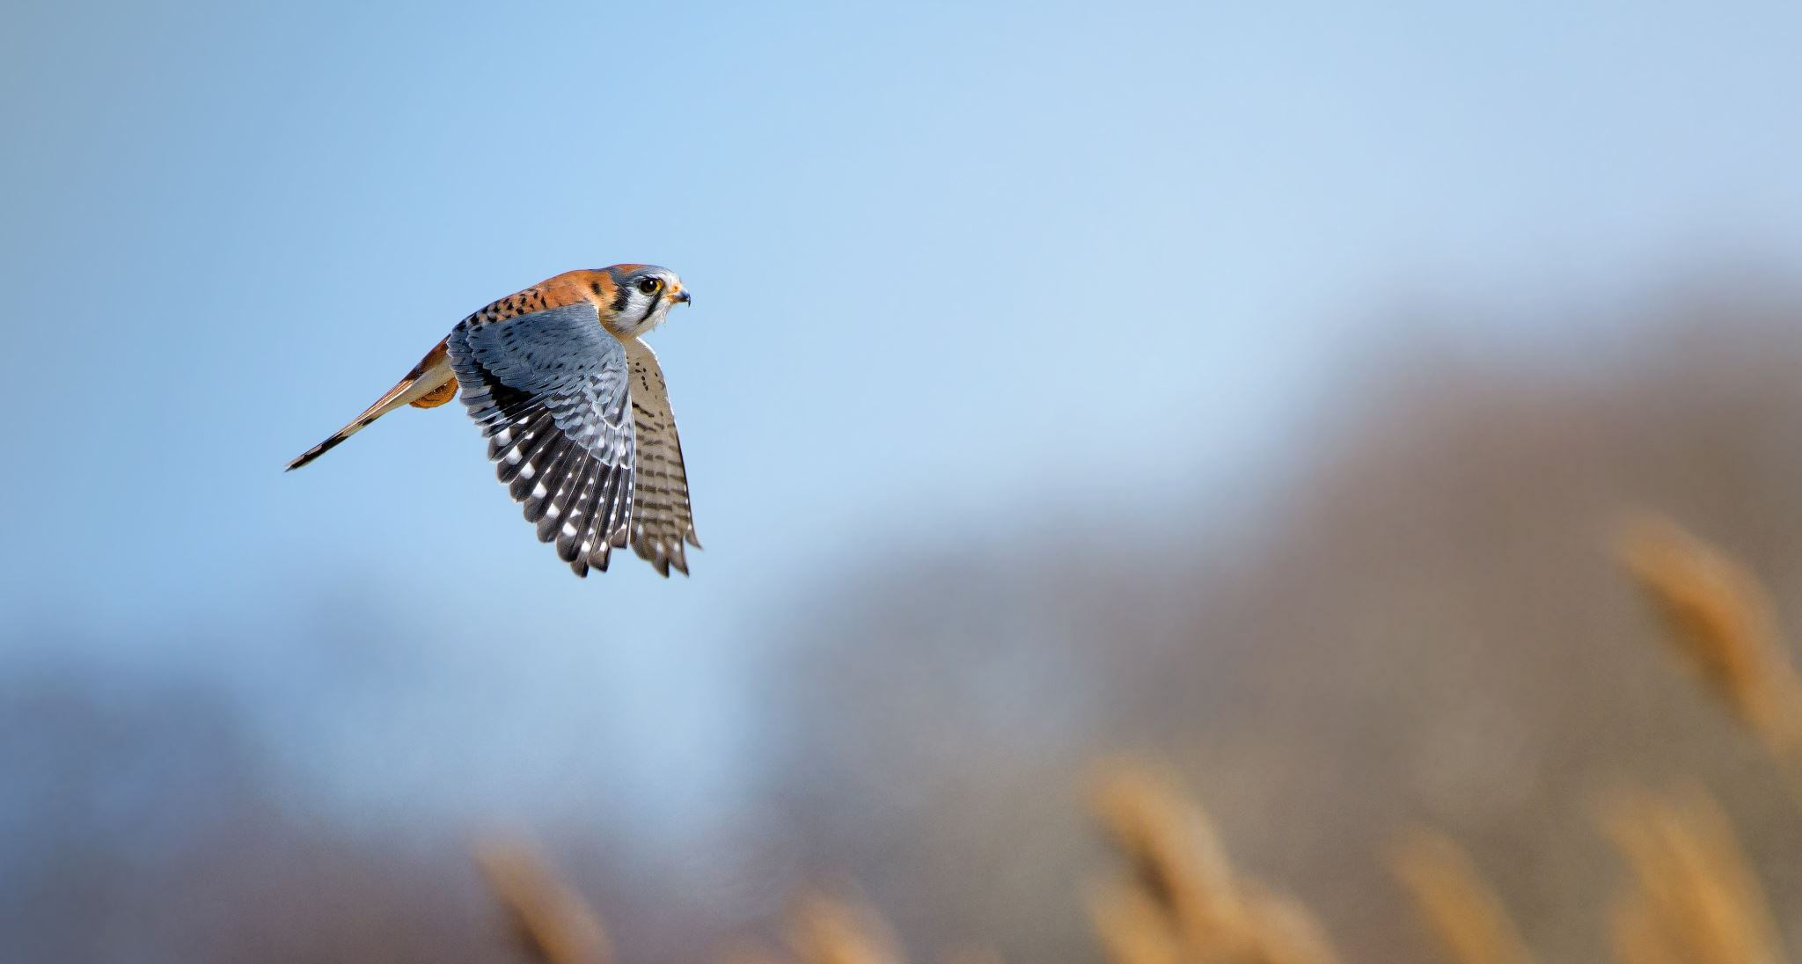
Welcome to Kestrel 2026/27

Slide 2
Meet the staff
My name is Mr Hughes and I am the class teacher.
My PPA slot is a Wednesday Morning
Miss Phillips will take the class, doing Art or DT, until breaktime
Mrs Fowkes (our new sports coach) will then take them for PE

Slide 3
Schedule of the Day
The doors open at 8:40 and will close at 8:50. If your child arrives after 9am, they will be marked as late.
We start the day with either a spelling or maths morning activity to get our brains into gear.
The first session will nearly always be an English session.
We will then have collective worship and then break from 10:15 to 10:35.
After break we will usually have maths.
Lunch is from 12:15 to 1:15
In the afternoons we will normally do two lessons, a mixture of all our topic areas.

Slide 4
What your child needs to bring
Reading record and school reading book EVERY DAY
A named water bottle and lunchbox if necessary
PE kits, in a bag and named – if your children do not have appropriate PE kit we will not let them join in the sessions.
A coat – we only have wet play if it is torrentially raining. We will be outside if its only drizzling so a coat is essential.
A healthy snack to eat at breaktimes. Children will not be allowed to eat unhealthy snacks at this time.

Slide 5
The Curriculum
We have a really exciting curriculum planned this year! I have already told the children some of what we will be learning this year and they were buzzing!
Our topics in Term 1 and 2 are:
History – Anglo-Saxons and Vikings
Science – Forces, Sound, Light and Electricity
Geography – The Northern and Southern Hemispheres
Art – Leonardo DaVinci
DT – Fairground Rides
RE – What do Christians learn from the creation story?

Slide 6
What’s going on this year?
SATs
This year the Year 6s in class have their end of year SATs.
We will be putting lots in place to support them throughout the year and help them achieve more than they ever thought possible.
I will be hosting a separate parent’s meeting about SATs closer to the time to go over all the information in more detail.

Slide 7
What’s going on this year?
Camp
We will be going to Kilve Court again in the Summer term in late June.
This is a really exciting opportunity for the Year 6s and is always great fun.
You will receive initial letters and information about payment in the next month or so.
I will host another specific parent’s meeting closer to the time to go over camp information in more detail.

Slide 8
Other useful information
We celebrate the children’s achievements in school on Fridays with our various certificates.
We have a stringent and rigid behaviour policy to ensure all children are treated fairly and equally.
Spellings will be test every Friday, it is important children practice regularly at home. Spelling lists will be given out in Week 3.
If you wish to communicate something with me, you could either chat with me before or after school or contact the office to arrange a formal meeting.
Attendance is monitored carefully. Year 6 are really important years in education and the children receive lots of new learning to help prepare them for secondary school and later life. Missing even one day can have a huge impact!

