Slide 1
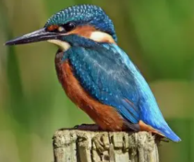

Welcome to Kingfisher Class

Slide 2
What our week looks like:
It has been lovely seeing everyone again after the summer holidays and catching up on all your children’s news. While many familiar faces have returned to Kingfisher Class, we would also like to extend a very warm welcome to the new families joining us this year.
Here is some useful class information for you which we will also share on our class page on the school website.
Teachers: Mrs Litt – Monday and Tuesday (alternate Wednesdays)
Mrs Bingham – Thursday and Friday (alternate Wednesdays)
Teaching Assistants: Mrs Phillips and Miss Nichols
PPA Cover: 1 hour on a Wednesday morning with Sports Coach – Mrs Fowks
1 hour on a Wednesday morning Guided Reading with Mrs Phillips and Miss Nichols.
School Day Timings
Classroom doors open at 8.40am for an 8.45am start.
End of the school day is 3.15pm.
PE Day: Monday and Wednesday.
PE Kit: White t-shirt, black shorts and daps/trainers.
Children are expected to change into their PE kits for PE lessons.

Slide 3


Useful information:
We are in the process of getting all of our class information on our Kingfisher class page on the school website.
If you haven’t had a look at the school website please do to become familiar with the layout. We will be adding information and photos of what we have been doing throughout the year for you to see on our class page.

Slide 4
What to bring to school every day:
- Named water bottle
- School bag and reading folder – which contains reading book and reading record.
- Named coat
- Healthy snack - This can be a piece of fruit or a fruit or cereal bar (NO chocolate bars or crisps). Please note that we are also a nut free school.
- Please do not bring toys/items that are special to school, we do not want them to get lost or broken.
- We also ask that the children do not bring in their own fidget toys from home. We have a good selection of fidgets in our calm corners that the children are welcome to use at school when needed.

Slide 5
Curriculum topics:
A copy of our Term 1 and 2 Theme overview will soon be shared with you on our class page on the school website. Please take a look to see what your children will be learning about.
During term one as Scientists, we will be exploring and learning about Forces, Sound and Light, Electricity. As Historians, we will be learning about life in Anglo-Saxon times and Viking invasions. As Geographers, we will be improving our Geography skills by using atlases and maps whilst learning about the Equator, Tropic of Cancer and the Tropic of Capricorn. Alongside these curriculum subjects, children will also be taking part in weekly RE, PE, Art, DT, Music and RSHE lessons.

Slide 6

Reading:
It is really important that you try to read with your child at home as much as possible. Please try and hear your child read at least three times a week and record in their reading record when you have read with them. Children should also be recording when they have read to themselves. For our whole school reading challenge, we count all the reads that your child does with an adult in school and at home. Reads will be counted at the end of each week and children can gain different certificates for the number of reads they achieve throughout the school year.

Slide 7
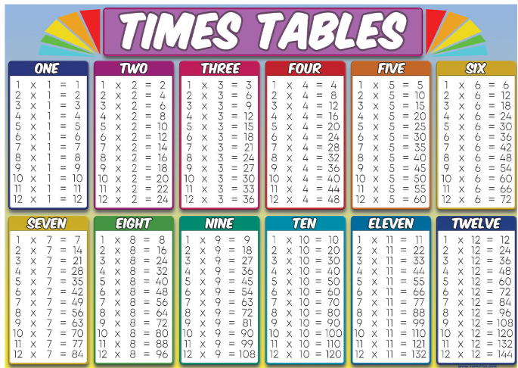
Year 4 Multiplication Tables Check (MTC):
This is a statutory multiplication check for all Year 4 children. The purpose of it is to determine whether pupils can recall their times tables fluently up to 12, through a set of 25 timed questions.
It takes place in June, we will be holding a Year 4 MTC information meeting for parents closer to this time. We will be working on times table fluency in class and would appreciate any extra practice you can do with your children at home.

Slide 8

Spellings/homework:
Spellings will be given out at the beginning of each term and labelled with the date. The children will practise these in school, but these will also need practising at home. There will then be a test every Friday morning. The spelling will be marked with the children so they will be aware of their scores. We may also give out more practical topic related homework projects throughout the year.
We will also send out extra times table activities for children to complete at home. Children will know their Times Table Rock Stars log-ins, this is a great way in encouraging them to practice.
https://ttrockstars.com Get them to show you what they do!

Slide 9
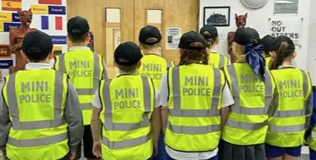
Mini Police:
We are pleased to announce that our school has been selected to take part in Mini Police this year. Mini Police is an exciting, interactive, voluntary opportunity for children aged 8 to 11 years old. The programme is delivered over nine weeks, and the aim is to introduce children to a positive experience of policing and to get them involved in the local community.
A letter to parents and guardians for consent for your children to take part in the Mini Police programme will be sent out shortly

Slide 10
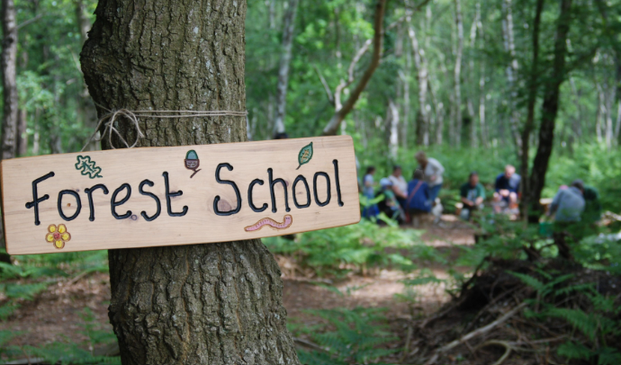
Forest School:
Your children will get the opportunity to take part in Forest school throughout the year. Becky is our Forest School Leader and the sessions will be led by her.
A message from school will be sent home to let you know when it is your child’s turn.
Your child will need appropriate outdoor clothes – they can get muddy and they use the fire pit. Likewise, children will need wellies or appropriate footwear. We are happy for them to leave their forest school bag in school. Forest school takes place in all weathers, so please think about sending in waterproofs if wet weather is forecast.

Slide 11
Attendance:
Attendance is monitored closely so please avoid taking holidays during term time, it would result in your child missing whole chunks of work.
Please ensure the office is informed if your child is going to be absent for any reason.

Slide 12
Communication:
We greet the children at the door every morning when the classroom door is opened.
Messages can be left for us at the school office.
The next parents evening is in October.
Information and newsletters can be found on the school website.
If you would like to talk to us about something and can’t catch us, please call the school office to arrange a phone call and we will call you back as soon as possible.

Slide 13
Behaviour and Rewards
Our behaviour policy can also be found on the school website. We have high expectations of all the children in Kingfisher Class.
We reward children for good behaviour through:
- Raffle tickets
- Hot chocolate Friday with Mrs Baker-Brown
- Certificates in Reading and Math challenges, Crew, Bee Proud, Writer of the week and achieving the Head Teacher’s Award.

Slide 14
Thank you for coming today
If you have any questions, please don’t hesitate to ask. We are available for any quick messages before school and normally free to have longer discussions after school. We are here to help as much as we can.
Thank you for your support, we look forward to working with you.
Mrs Litt and Mrs Bingham.

