Slide 1
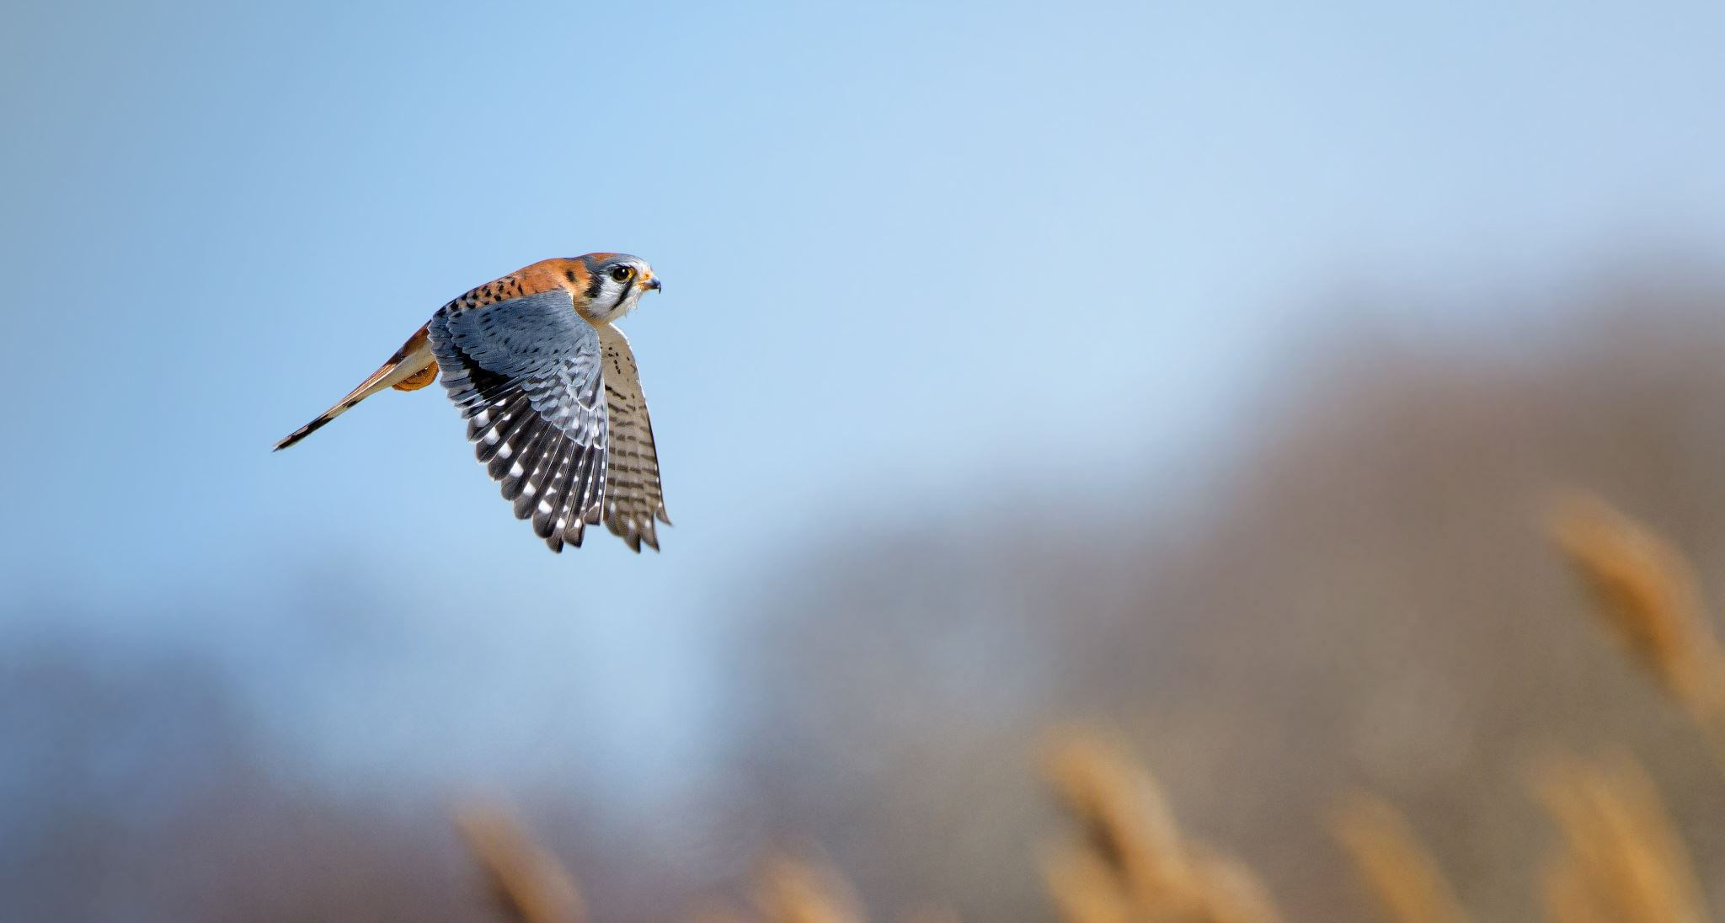
Welcome to Kestrel 2025/26

Slide 2
Meet the staff
My name is Mr Hughes and I am the class teacher.
Our TAs are:
Miss Phillips on a Tuesday, Wednesday and Friday
Mr Lyness on Monday. He is also our new sport’s coach who will teach PE.
Mrs Walton on Thursdays
Mrs Baber will assist the class during Maths sessions.
My PPA slot is Monday afternoons, during this session the class will have half PE and half a topic lesson with Mrs Baker Brown or Mrs Bingham.

Slide 3
Schedule of the Day
The doors open at 8:40 and will close at 8:50. If your child arrives after 9am, they will be marked as late.
We start the day with either a spelling or maths morning activity to get our brains into gear.
The first session will nearly always be an English session.
We will then have collective worship and then break from 10:35 to 10:50.
After break we will usually have maths.
Lunch is from 12:15 to 1:15
In the afternoons we will normally do two lessons, a mixture of all our topic areas.

Slide 4
What your child needs to bring
Reading record and school reading book EVERY DAY
A named water bottle and lunchbox if necessary
PE kits, in a bag and named – if your children do not have appropriate PE kit we will not let them join in the sessions.
A coat – we only have wet play if it is torrentially raining. We will be outside if its only drizzling so a coat is essential.
A healthy snack to eat at breaktimes. Children will not be allowed to eat unhealthy snacks at this time.

Slide 5
The Curriculum
We have a really exciting curriculum planned this year! I have already told the children some of what we will be learning this year and they were buzzing!
Our topics in Term 1 and 2 are:
History – World War 1 and 2
Science – Changing States of Matter
Geography – Space and Scale – Continents
Art – Elizabeth Frink
DT – Electrical Circuits
RE – What does it mean if God is holy and loving?

Slide 6
What’s going on this year?
SATs
This year the Year 6s in class have their end of year SATs.
We will be putting lots in place to support them throughout the year and help them achieve more than they ever thought possible.
I will be hosting a separate parent’s meeting about SATs closer to the time to go over all the information in more detail.
Year 5s will still receive a high quality of teaching and get lots of focus on their learning.

Slide 7
What’s going on this year?
Camp
We will be going to Kilve Court again in the Summer term in late June.
This is a really exciting opportunity for the Year 6s and is always great fun.
You will receive initial letters and information about payment in the next month or so.
I will host another specific parent’s meeting closer to the time to go over camp information in more detail.

Slide 8
What’s going on this year?
Space Camp
We will be hosting Space Camp again for the Year 5s in the Summer months.
This is always a great event and a chance for children to engage in the Science curriculum in a more practical way.
I will give you more specific and relevant information about this closer to the time!

Slide 9
What’s going on this year?
Swimming
In the Summer term, the Year 5s will be going swimming.
We will probably be going to Clevedon Leisure Centre again.
This will run on Fridays for the length of Term 5.

Slide 10
Other useful information
We celebrate the children’s achievements in school on Fridays with our various certificates.
We have a stringent and rigid behaviour policy to ensure all children are treated fairly and equally.
Spellings will be test every Friday, it is important children practice regularly at home.
If you wish to communicate something with me, you could either chat with me before or after school or contact the office to arrange a formal meeting.
Attendance is monitored carefully. Year 5 and 6 are really important years in education and the children receive lots of new learning to help prepare them for secondary school and later life. Missing even one day can have a huge impact!

