Slide 1


Welcome to Robin Class

Slide 2
What our week looks like:
Teachers: Mrs Fear – Monday and Tuesday
(Tues pm SENDCO Time covered by Sports Coach and Mrs Bingham)
Mrs Sims – Wednesday, Thursday and Friday
Teaching Assistants: Miss Nichols – Monday and Friday
Mrs Walton – Tuesday, Wednesday
Mrs Midgley Green - Thursday
PPA Cover: Friday first session with Sports Coach – Mr Lyness
School Day Timings
Classroom doors open at 8.40am for an 8.45am start.
End of the school day is 3.15pm.
PE Day: Tuesday and Friday. PE Kit: White t-shirt, black shorts and daps/trainers.
Children are expected to change into their PE kits for PE lessons.

Slide 3
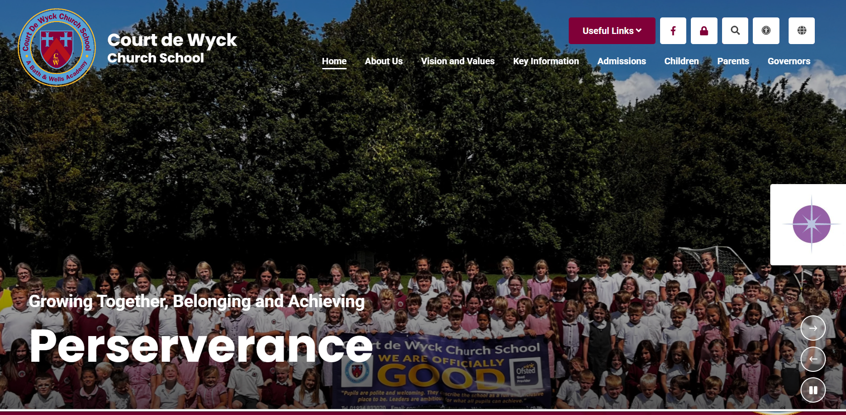

Useful information:
It has been lovely seeing Robin class again over these first few days back - they have all had a very positive start to the new school year and supported the new Reception starters brilliantly.
We have a wonderful new school website and we are in the process of getting all of our class information on there. If you haven’t had a look yet please do so to become familiar with the new layout. We will be adding information about our new learning themes and photos of what we have been doing throughout the year for you to see on our class page.

Slide 4
What to bring to school every day:
Named water bottle
School bookbag containing their reading book folder and reading record.
Named coat
Fruit - School fruit is provided daily for Year 1 and 2 children. We never know what this fruit may be, so you may want to provide a healthy snack for break time to ensure your child has something they like. This can be a piece of fruit or a fruit or cereal bar (NO chocolate bars or crisps).
Please remember that we are a NUT FREE school.
Please do not bring toys to school.
*Milk - You have the option to pay for milk for your child to have every day by ordering directly from the dairy - School Milk Services . Please see the school office if you require information about this.
PE Kits – stay in school and are sent home every half term.

Slide 5
Topic themes:
Theme overview – this will soon be on our class page on the school website.
This will look slightly different from the Reception grid you are used to as the Year 1 children will be following the Key Stage One National Curriculum in all subject areas e.g. History, Geography, Science, Design & Technology, Music, Art, RHSE and PE.
Show and Tell will continue to be on Fridays.
For our first learning theme for Terms 1&2 we will look at “What makes our local area special?” with a focus on Clevedon Pier.

Slide 6

Reading:
It is really important that you try to read with your child at home as much as possible. We aim for 5 reads a week as a minimum.
Please try and hear your child read every day and record in their reading record when you have read with them.
For our whole school reading challenge, we count all the reads that your child does with an adult in school and at home. Reads will be counted at the end of each week and the children gain different certificates for the number of reads they achieve throughout the school year.

Slide 7
Spellings/homework:
Reading everyday at home is an expectation.
Y1 children will also have a spelling word list which will be given out at the beginning of each term and labelled with the date. The children will practise these spellings in school, but these will also need practising at home.
They will be a mixture of non decodable Common Exception Words and words following a familiar phonics spelling rule each week.
If spelling sheets get lost, please ask for another one. Spellings can be also found on our Robin Class page.
There will be a spelling check every Friday morning. The spellings will be marked with the children so they will be aware of their scores. We will put a sticker in their reading record so you know how they are getting on.
We may also give out more practical topic related homework projects throughout the year.

Slide 8
Attendance:
Attendance is monitored closely so please avoid taking holidays during term time, it would result in your child missing whole chunks of work.
Please ensure the office is informed if your child is going to be absent for any reason.

Slide 9
Forest School:
Each class will have the opportunity to take part in a Forest School Club which will be taking place during a Tuesday lunch time.
The children will get changed, eat their lunch and then meet Becky our forest school leader. The session is led by her.
We will let you know when it is our class turn for their block of sessions.
Your child will need appropriate outdoor clothes to change into as they can get muddy and sometimes smell smoky when they use the fire pit. They will also need wellies or appropriate outdoor footwear. We are happy for the children to leave their forest school bag in school. Forest School takes place in all weathers, so please think about sending in waterproofs if wet weather is forecast.

Slide 10
Communication:
We greet the children at the Robin class gate every morning when the classroom door is opened. Please encourage your child to be independent walking in by themselves.
Our first Parents Evening will be taking place in October.
Information can be found on the school website and in our school newsletters which are fortnightly on a Friday.
If for some reason you can’t catch us at the door messages can be left for us at the school office or via the school enquiries email and we will endeavour to get in touch with you as soon as we can.

Slide 11
Behaviour and Rewards:
Our Trust and School Behaviour Policy can be found on the school website.
We have high expectations of all the children in Robin Class.
We reward children for good behaviour through:
- Raffle tickets
- Hot chocolate Friday with Mrs Baker-Brown
- Certificates in Reading, Crew, Bee Proud, Writer of the Week and the Head Teacher’s Award

Slide 12
Thank you for coming today!
If you have any questions, please don’t hesitate to ask. We are available for any quick messages before school and normally free to have longer discussions after school.
We are here to help as much as we can and look forward to working together with you and your family.
Thank you for your support,
The Robin Class Team

