Slide 1
Year 6 SATs
Information for Parents

Slide 2
When are SATs taking place this year?
Monday 13th May – Thursday 16th May

Slide 3
The Tests
Statutory tests will be administered in the following subjects:
• Punctuation, Vocabulary and Grammar (45 minutes)
• Spelling (approximately 15 minutes)
• Reading (60 minutes)
• Mathematics -
Paper 1: Arithmetic (30 minutes)
Paper 2: Reasoning (40 minutes)
Paper 3: Reasoning (40 minutes)
All tests are externally marked.

Slide 4
Writing
As in recent years, writing will be teacher assessed internally.
The ‘pupil can’ statements for English writing have been updated and place a greater emphasis on composition and the statements that relate to the more ‘technical’ aspects of English writing (grammar, punctuation and spelling) have been made less prescriptive.

Slide 5
Reading
The reading test consists of a single test paper with three unrelated reading texts.
Children are given 60 minutes in total, which includes reading the texts and answering the questions.
A total of 50 marks are available.
Questions are designed to assess the comprehension and understanding of a child’s reading.
During the reading paper, a child’s inference and deduction skills are thoroughly tested.

Slide 6
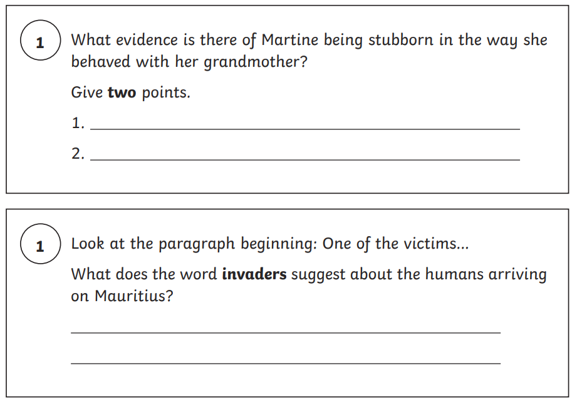
Reading: Sample Questions

Slide 7
Spelling, Punctuation and Grammar
Paper 1 of the spelling, punctuation and grammar test focuses on vocabulary, punctuation and grammar. This test lasts for 45 minutes and requires short answer questions including some multiple choice. A total of 50 marks are available.
Paper 2 is a spelling test containing 20 words, which lasts approximately 15 minutes. A total of 20 marks are available. Marks for these two tests are added together to give a total out of 70 for spelling, punctuation and grammar.

Slide 8
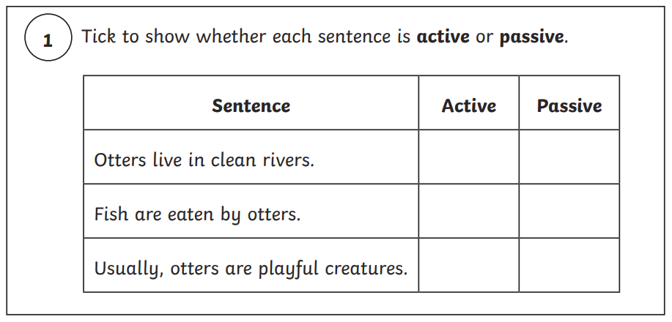
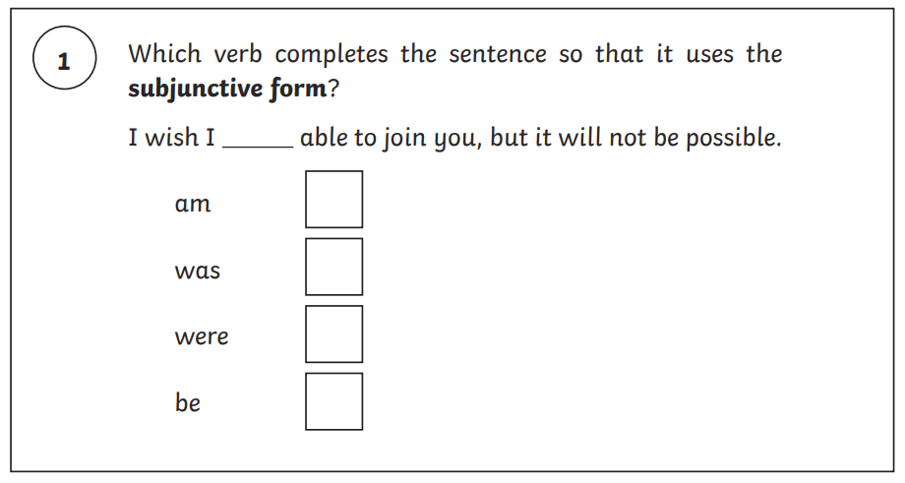
SPaG: Sample Questions

Slide 9
Mathematics
For mathematics, children will sit three tests: paper 1, paper 2 and paper 3.
Paper 1 is for arithmetic lasting for 30 minutes, covering calculation methods for all operations, including use of fractions, percentages and decimals. Questions gradually increase in difficulty. Not all children will be expected to access some of the more difficult questions later in the paper.
Papers 2 and 3 cover problem solving and reasoning, each lasting for 40 minutes. Pupils will still require calculation skills but will need to answer questions in context and decide what is required to find a solution.

Slide 10
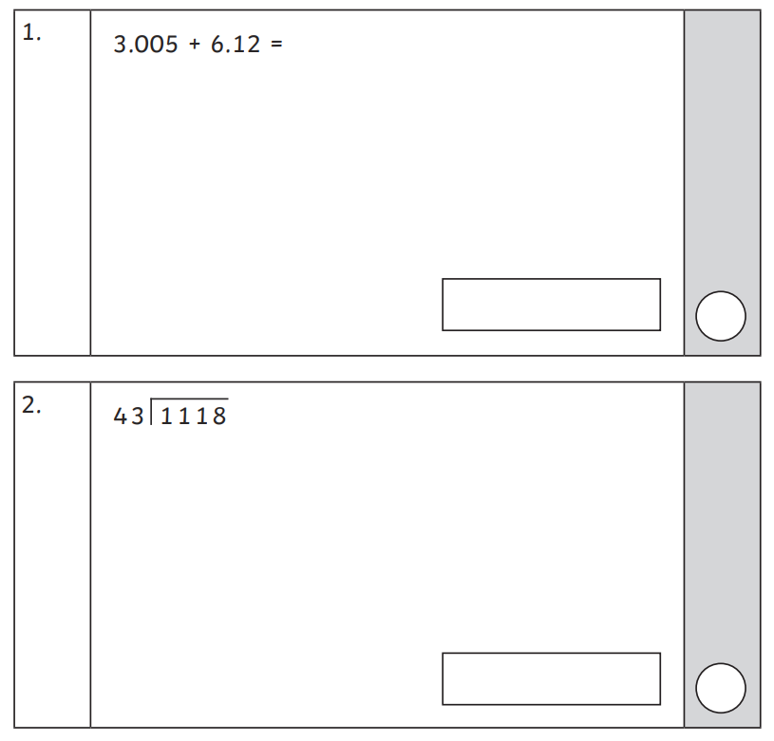
Arithmetic: Sample Questions

Slide 11
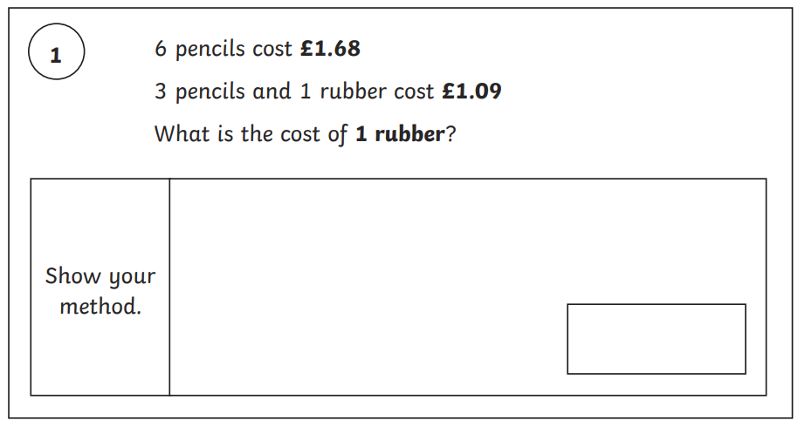
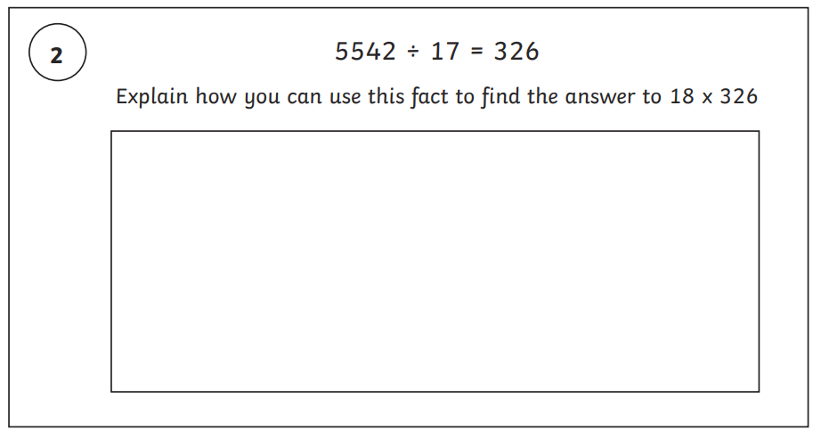
Reasoning: Sample Questions

Slide 12
Scaled Scores
What is meant by ‘scaled scores’?
It is planned that 100 will always represent the ‘national standard’.
Each pupil’s raw test score will therefore be converted into a score on the scale, either at, above or below 100.
Using the scaled score, the lowest a child can score is 80, with the highest being 120.
A child who achieves the ‘national standard’ (a score of 100) will be judged to have demonstrated sufficient knowledge in the areas assessed by the tests.
Each pupil receives:
• a raw score (number of raw marks awarded);
• a scaled score in each tested subject;
• confirmation of whether or not they attained the national standard

Slide 13
Results Day
Results will be published in July.
On publication of the test results in July:
• a child awarded a scaled score of 100 is judged to have met the ‘national standard’ in the area judged by the test.
• If a child’s score is close to 120, they are working beyond (or above) the expected national standard.
• a child’s score is close to 80, they are judged to have not yet met the national standard and performed below the expectation for their age.

Slide 14
What have we been doing in school to support your child?
Continued to teach the curriculum
Revisited previous learning daily – e.g. fluent in five
Practice test papers
Individualised support for the children during intervention times
Targeted reading for some pupils
Identified strengths and weaknesses to inform next steps
Tried to reassure, encourage and support!

Slide 15
How can you help your child at home?
• First and foremost, support and reassure your child that there is nothing to worry about and that they should always just try their best. Praise and encourage!
• Ensure your child has the best possible attendance at school.
• Support your child with any homework tasks.
• Reading, spelling and arithmetic (e.g. times tables) should be completed every day.
• Make sure your child has a good sleep and healthy breakfast every day!

Slide 16
How to help your child with reading:
Listening to your child read can take many forms:
• First and foremost, focus on developing an enjoyment and love of reading.
• Enjoy stories together – reading stories to your child is equally as important as listening to your child read.
• Read a little at a time but often, rather than rarely but for long periods of time!
• Talk about the story before, during and afterwards – discuss the plot, the characters, their feelings and actions, how it makes you feel, predict what will happen and encourage your child to have their own opinions.
• Look up definitions of words together – you could use a dictionary, the Internet or an app on a phone or tablet.
• All reading is valuable – it doesn’t have to be just stories. Reading can involve anything from fiction and non-fiction, poetry, newspapers, magazines, football programmes, TV guides.

Slide 17
How to help your child with writing:
• Practise and learn weekly spelling lists – make it fun!
• Encourage opportunities for writing such as letters to family or friends, shopping lists, notes or reminders, stories and poems.
• Write together – be a good role model for writing.
• Encourage use of a dictionary to check spelling and a thesaurus to find synonyms and expand vocabulary.
• Allow your child to use a computer for word processing, which will allow for editing and correcting of errors without lots of crossing out.
• Remember that good readers become good writers! Identify good writing features when reading (e.g. vocabulary, sentence structure and punctuation).
• Show your appreciation: praise and encourage, even for small successes!

Slide 18
How to help your child with maths:
Times tables, times tables, times tables!
CGP books
IXL - Year 6 maths practice
Free KS2 SATS Online 10-Minute Tests | CGP Books
Practice SATs papers – GOV website
Free KS2 SATs Papers - Practice Arithmetic Papers (myminimaths.co.uk)

Slide 19
Questions

