Slide 1

Welcome to Owls.

Slide 2
Class Logistics.
Teachers: Mrs Howe - Monday, Wednesday AM, Thursday and Friday
Mrs Bingham - Tuesday
PPA Cover - Mrs Chaplow and Sports Coach - Wednesday PM
Teaching Assistant - Mrs Last
P.E - Tuesday and Wednesday
Book change and Spellings - Friday
What you need each day: A named water bottle, a school book bag, a hat if sunny and a coat when rain is indicated. P.E kits stay in school and get sent home at the ned of every term.
Milk and snacks.
No toys please.

Slide 3
How we organise a split year class
Year groups are split for phonics and maths.
Year 2 will move to Goldfinch for these subjects.
Individual children may stay in Owl’s if this best meets their needs.
Maths in Year 2 will always be taught by Mrs Bingham or Mrs Litt.
Year 1 maths will rotate termly (6 terms per year) and will either be taught by myself or Mrs Chaplow. I will always plan for these.

Slide 4
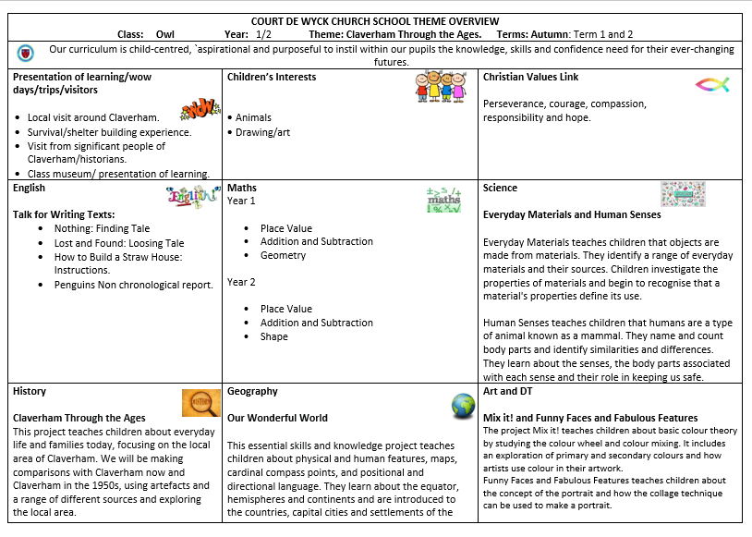
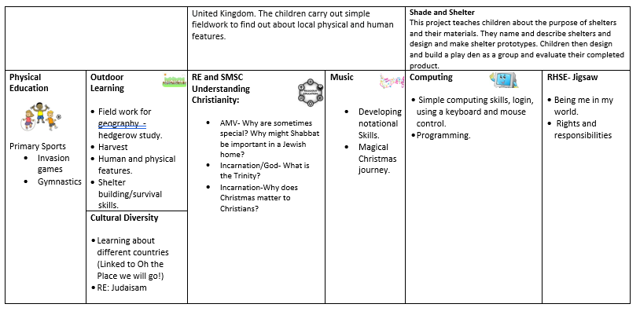
This term

Slide 5
Communication
Greeting – open door
Via the school office
Parent’s evening
School website
Arrange a phone call
Paper work

Slide 6
Behaviour and rewards.
Behaviour policy on school website.
Consistent
High expectations
Individual
Rewards – raffle tickets, recognition boards, hot chocolate with Mrs BB.
Certificates – Reading, Crew, Bee proud and Headteachers awards

Slide 7
Spellings and Reading
Reading 5 times a week – 3 minutes is better than nothing.
Spellings – link with phonics scheme
Key part of spellings – common exception words
Fun ways to teach spellings on website.
Home school link

Slide 8
Book club.
No show and tell
Friday book club instead
Once a week on a rota
Bring in favourite book and present to the class. If too shy can always send a video via the office or bring notes and I will present.

Slide 9
Any questions?

