Slide 1


Kilve 2025
Information Meeting
20.5.25

Slide 2


Key details
Information pack containing all the details about the trip including some important forms which need to be filled in and returned ASAP.
We will be leaving from school at 9.45am on Monday 16th June in order to be at Kilve in time for lunch - please make sure your child has a packed lunch with them.
Your child must have all of their luggage in a bag that they can carry themselves!!

Slide 3

What to bring
Full kit list has been provided in your information packs, some key things to note are:
Enough changes of suitable clothing for all of the activities we will be doing
Old trainers/wellies for outdoor activities- they will need two pairs of trainers as it is likely one will get wet.
It is really important that shoes are comfortable and broken in, so they don’t rub
Slipper socks, slippers or thick socks to wear inside as shoes are not allowed indoors
Waterproofs, shorts, t-shirt, hats and
sun cream to cover all possibilities weather
wise!
A pillow, bed sheet and duvet/sleeping bag
Toiletries and towel
Water bottle

Slide 4
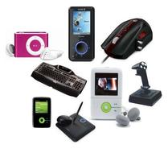




What NOT to bring
Food and drink (other than water bottles) are not allowed in the bedrooms at all- but you can pack your child a small tupperware box with snacks which they will have access to at certain times throughout the day
No electronic gadgets are allowed except for digital cameras which the children must be responsible for charging and looking after
No jeans as these can be too restrictive – except disco!
STRICTLY NO MOBILE PHONES

Slide 5


Points to note
Please make sure all items are clearly labelled with your child’s name
They will be expected to pack their own luggage at the end of the trip so please make sure they know how to do this
You can provide pocket money but this cannot be more than £10 - it will be your child’s responsibility to look after it! Change is better – ice cream.

Slide 6
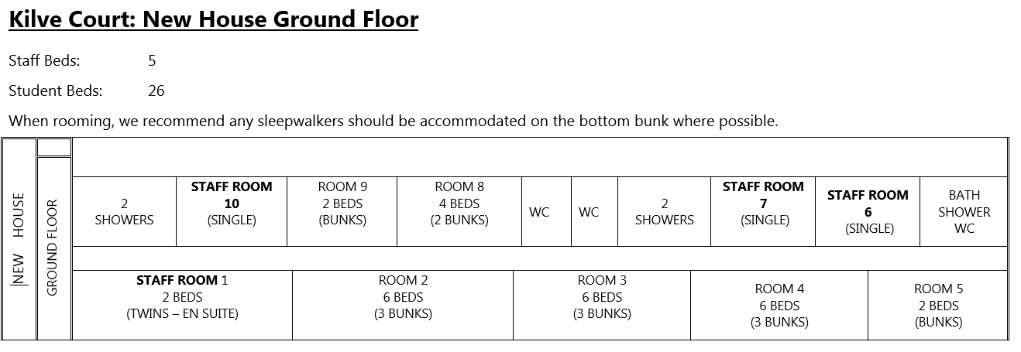
Dormitories

Slide 7
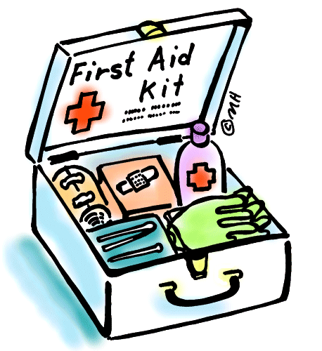
First Aid
Miss Brown and Mr Tiddy are the designated First Aiders for the trip and there will be trained First Aiders at Kilve too
You should have filled in and returned the information form detailing
any medical needs
Please note the guidance in
the pack around travel sickness

Slide 8
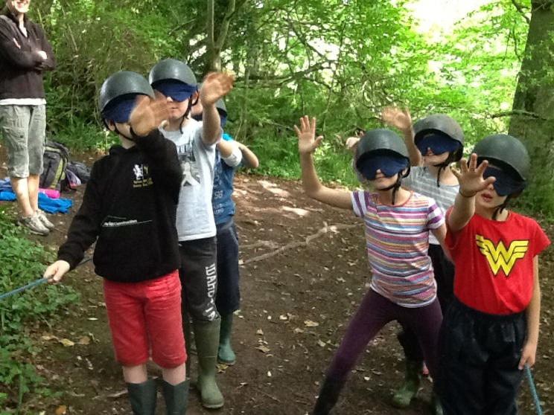
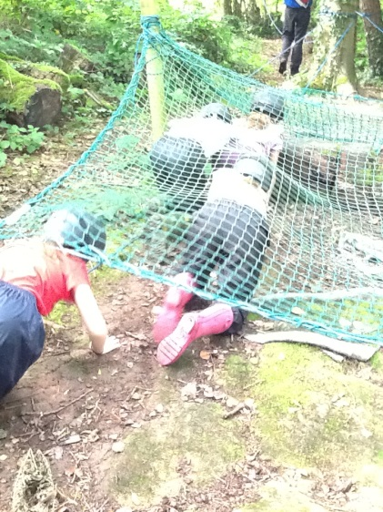
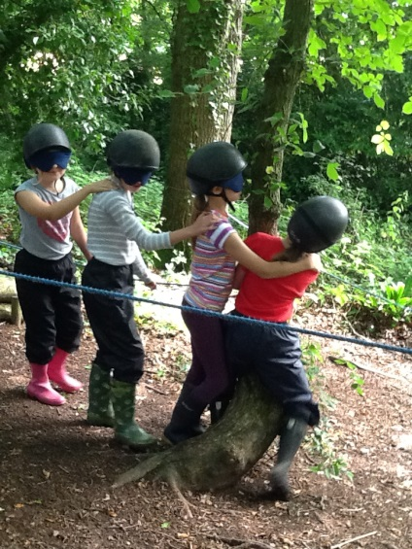
What to expect
Abseiling
Climbing wall
Mountain Biking
Fantasy Trail/Night line
Rifle Shooting
Grass sledging
Beach visit
Disco
Fun! Fun! Fun!
SSE Outdoors Kilve Court, The ODC and Great Wood on the Quantock Hills 2020 - YouTube

Slide 9
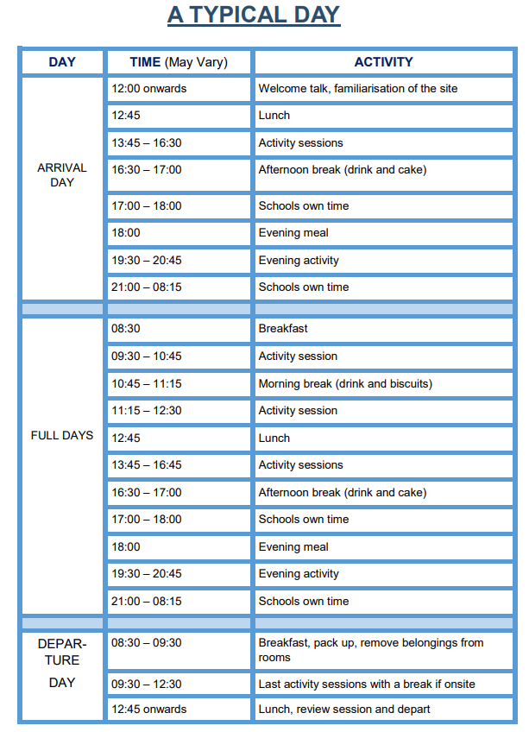

Slide 10
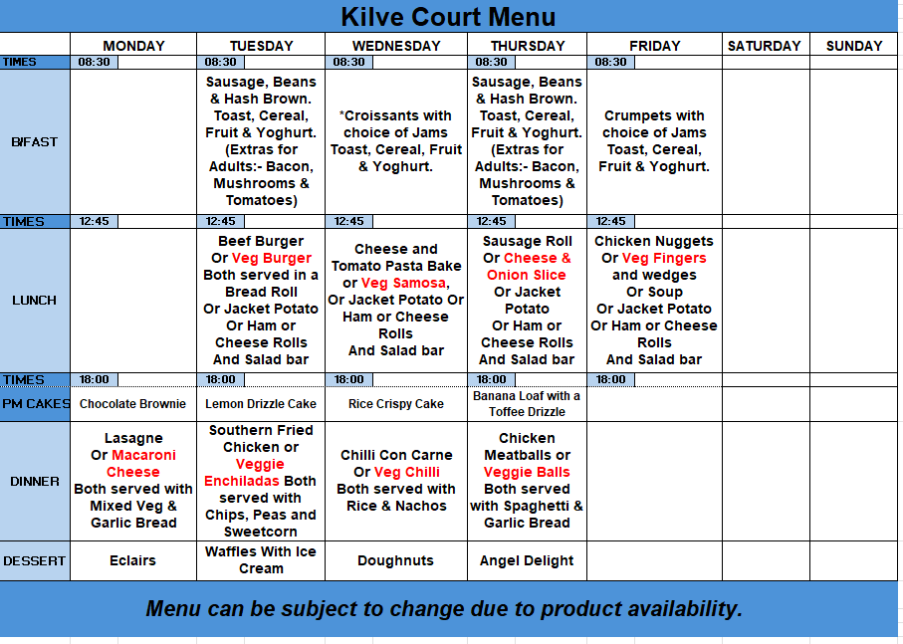
Food Menu

Slide 11
Communication
The office will text all parents to let them know when we have arrived safely.
I will text the office at the end of every day to give an update of what the children have been up to – this message will be sent to you – different on the Wednesday
Homesickness

Slide 12
Returning
We will be returning on Friday 20th June at approximately 2.30pm.
The office will send a text out when we are 20 minutes away from school. You will have the option to greet your child at school and take them home early if you wish!

Slide 13
Any Questions?

