Slide 1
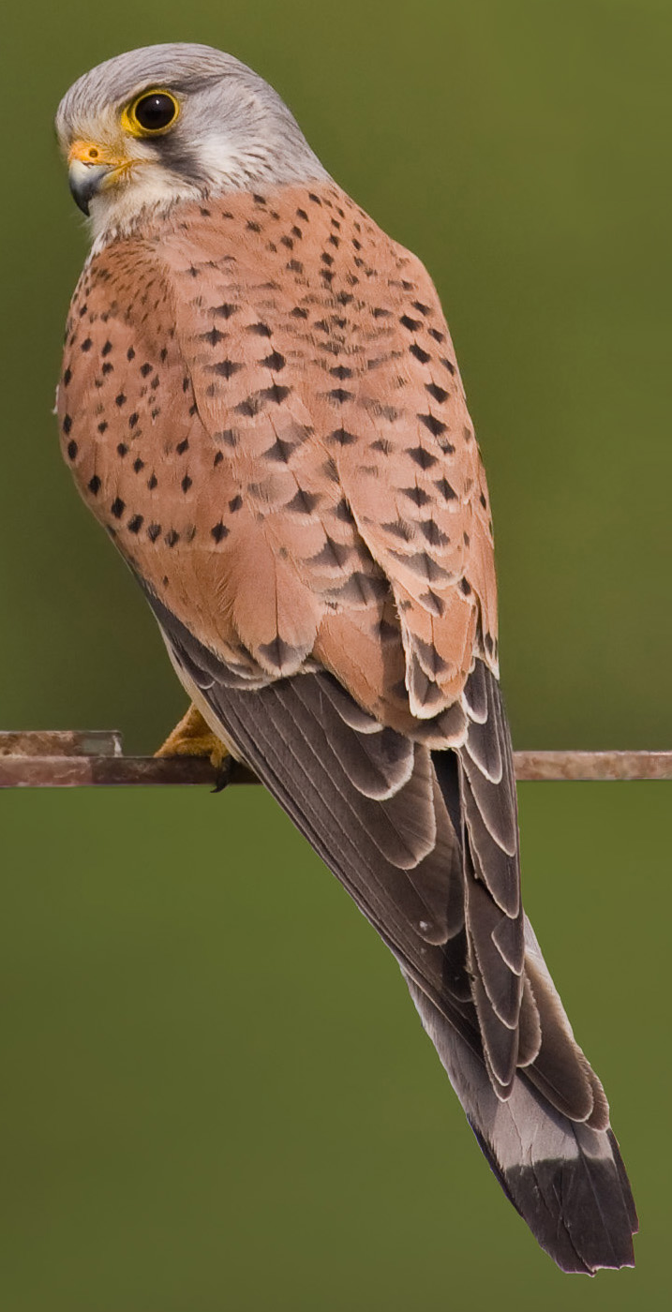
Welcome to Kestrel Class

Slide 2

Running of the day
Gates open at 8.35am for the school day to start at 8.45am.
3.15pm – end of day

Slide 3
The Team
Class Teacher – Miss Brown
Learning support assistant – Mr Tiddy
Learning support assistant – Mrs Last
Learning support assistant – Mrs Walton
Sports coach – Miss Nilsson

Slide 4

PE Days
Friday and Thursday.
It is recommended that all children bring their PE kits with them on Monday for the start of the week.
All children are expected to have appropriate PE kit.

Slide 5

What your child should have with them for a school day:
Water bottle
Snack for breaktime
Lunch
Jumper
Raincoat
PE kit
Reading book and reading record
Appropriate uniform

Slide 6


Homework
Spellings
Reading
Times tables

Slide 7
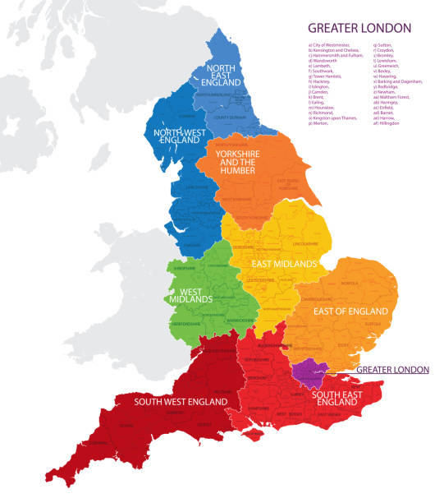

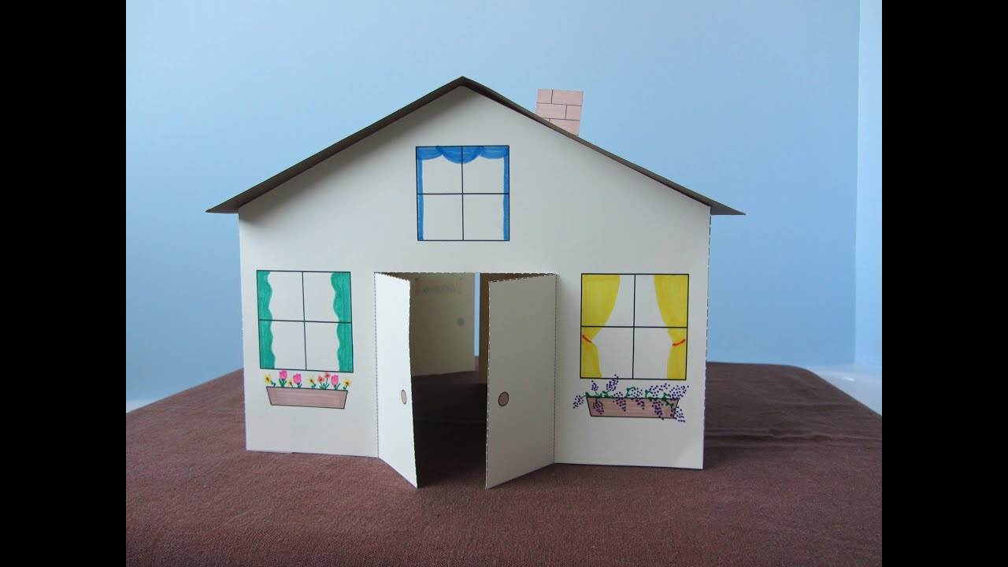
Topics (Term 1)
Topic information will be sent home at the start of each term.
Trips, WOW days, visitors, learning presentations

Slide 8
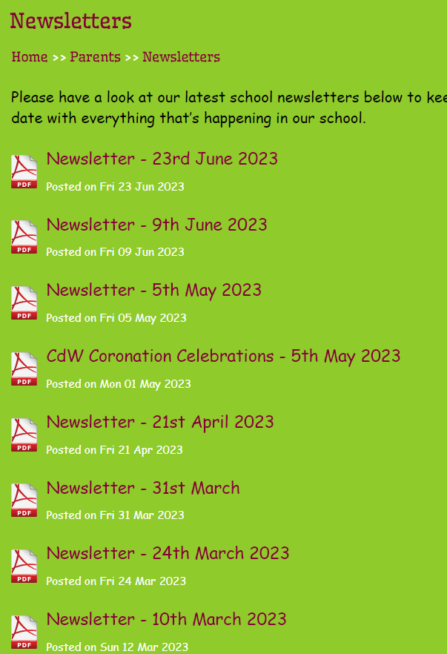
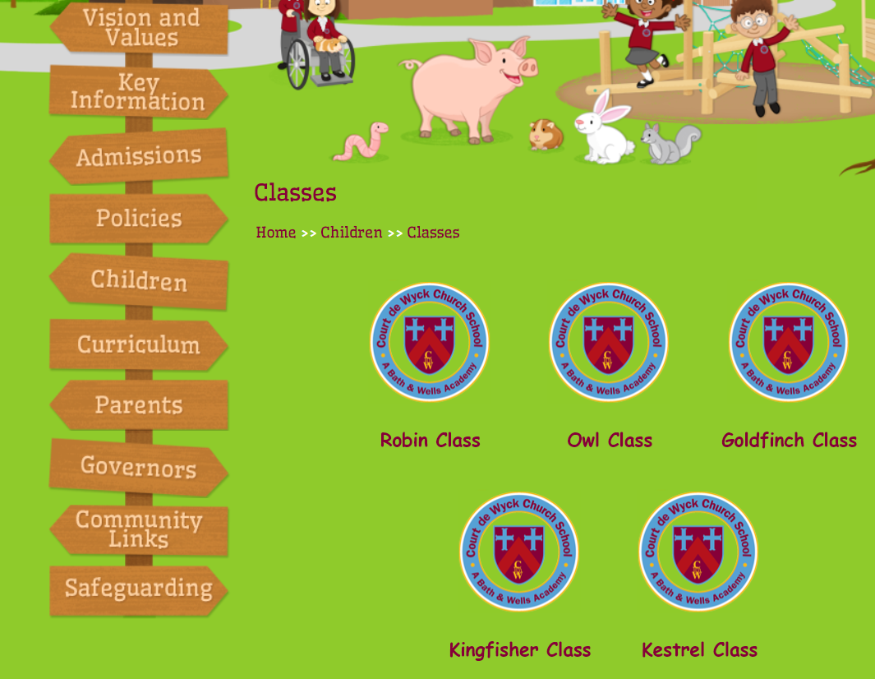
Website and Newsletter

Slide 9


Attendance

Slide 10

SATs

Slide 11
Secondary School Deadline
31st October
Backwell Open Evening – Thursday 26th September
Nailsea Open Evening - Thursday 19th September
Churchill Open Evening – Wednesday 25th September

