Slide 1

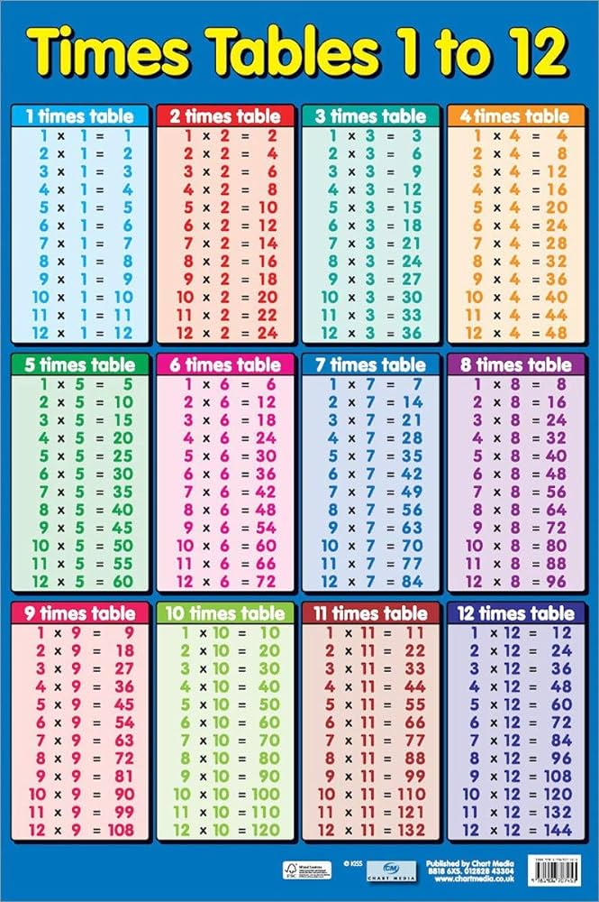
Multiplication Check information for Parents

Slide 2
What is the check for?
The purpose of the check is to determine whether your child can fluently recall their times tables up to 12, which is essential for future success in mathematics. It will also help your child’s school to identify if your child may need additional support.

Slide 3
How does the check work?
It is an on-screen check consisting of 25 times table questions. Your child will be able to answer 3 practice questions before taking the actual check. They will then have 6 seconds to answer each question. On average, the check should take no longer than 5 minutes to complete.
Your child will complete this independently it the IT suite with the supervision of Mr Hughes. If necessary, Mr Hughes can type for your child. This can help with making the test less stressful.

Slide 4
When will the check be?
The check will take place in Term 6. The test must be done in between 2nd June and 13th June. As a school, we can choose when in this period to complete the test. We will let you know the specific date closer to the time.

Slide 5
What are we doing to support your child?
As part of their maths lessons they are doing daily times tables warm up
At least 3 times a week, I am teaching specific times tables lessons.
Children are getting quickfire individual practice with an adult a few times a week.
As we get closer to the check, Mr Hughes will host focussed one-on-one practice with your child at least once a fortnight.
Children are given multiple opportunities a term to go into the IT suite to practice on TT rockstars.

Slide 6
What can you do to support your child?
Encourage them as much as possible to practice on TT Rockstars. The best game to practice for the check is called ‘Soundcheck’ as it is most like the actual check. All the games are brilliant though!
Children at the end of last term took home a laminated copy of the times tables. They could use these to create their own times tables posters at home.
You could also use these sheets to practice speedy recall with them.
The children enjoy times table chanting in class. The more actions and different rhythms the better!
Ask your child! We do so many different strategies in class and they will have preferences. See how they enjoy to practice and do it that way. The more they enjoy it, the more it will stick.

Slide 7
Extra information
This powerpoint will be on the school website if you wish to check it again in future.
There is loads of information on this website:
Multiplication tables check - GOV.UK (www.gov.uk)
Don’t hesitate to contact me if you have any questions or queries or want some more ideas to help support your child!
Thank you! Any questions?

