Slide 1

Welcome to Owls.

Slide 2
Class Logistics.
Teachers: Mrs Howe – Monday, Tuesday, Wednesday AM, Thursday
PPA Cover - Mrs Brady and Miss Nillson - Wednesday PM
Leadership time – Every Friday covered by Mrs Brady
P.E - Tuesday and Wednesday
Book change and Spellings - Friday
What you need each day: A named water bottle, a school book bag, a hat if sunny and a coat when rain is indicated. P.E kits stay in school and get sent home at the ned of every term.
Milk and snacks.
No toys please ( unless otherwises discussed)

Slide 3
How we organise a split year class
Year groups are split for phonics and maths.
Year 2’s will move to Goldfinch for these subjects.
Individual children may stay in Owl’s if this best meets their needs.
Maths in Year 2 will always be taught by Mrs Bingham or Mrs Litt.
Year 1 maths will be taught by myself.

Slide 4
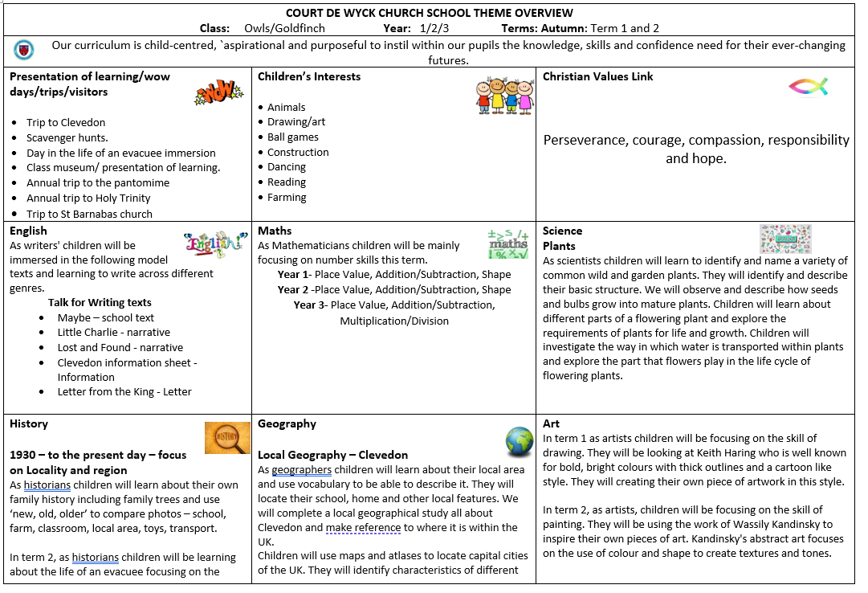
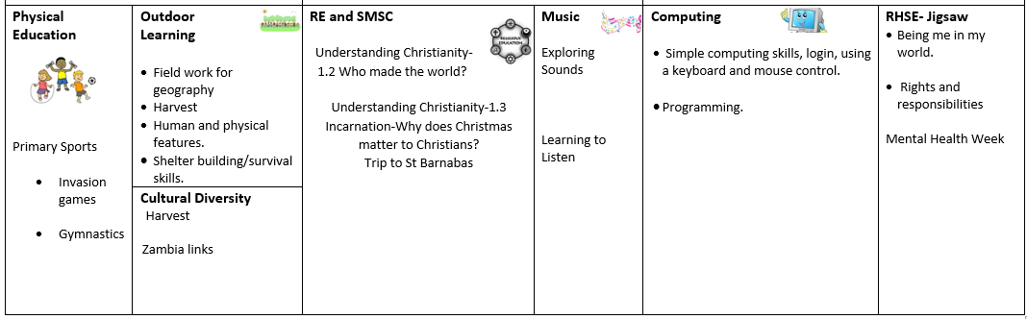
This term

Slide 5
Communication
Greeting – open door
Via the school office
Parent’s evening
School website
Arrange a phone call
Paper work

Slide 6
Behaviour and rewards.
Behaviour policy on school website.
Consistent
High expectations
Individual
Rewards – raffle tickets, recognition boards, hot chocolate with Mrs BB.
Certificates – Reading, Crew, Bee proud and Headteachers awards

Slide 7
Spellings and Reading
Reading 5 times a week – 3 minutes is better than nothing.
Spellings – link with phonics scheme
Key part of spellings – common exception words
Fun ways to teach spellings on website.
Home school link

Slide 8
Book club.
No show and tell
Friday book club instead
Once a week on a rota
Bring in favourite book and present to the class. If too shy can always send a video via the office or bring notes and I will present

Slide 9
Any questions?

